Slide 1
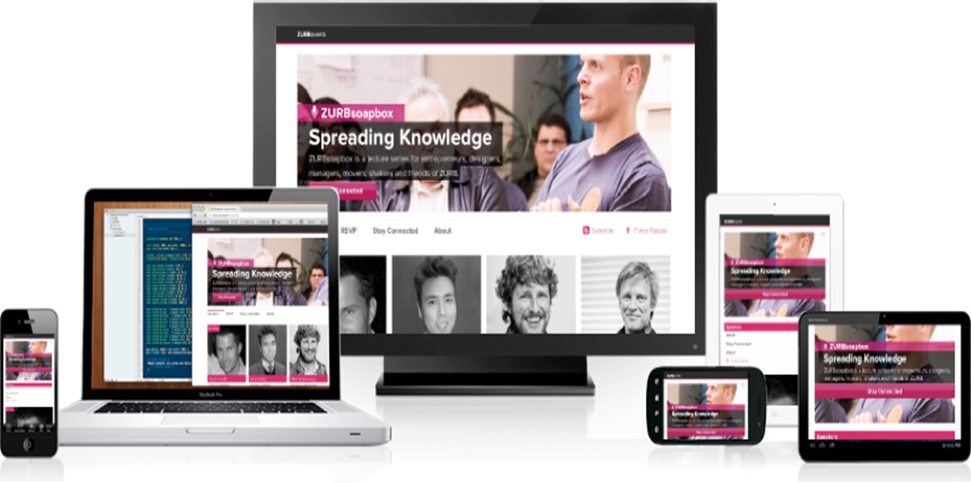
CAP782:Responsive Web Design
“Building a web, for all device ”

Slide 2
Contents
Mobile is Future
What is Responsive Web Designs
Why do you need Responsive web designs
Adoptive vs Responsive web designs
Key benefits of Responsive web designs
How does it works
How you can implement Responsive Websites
Frameworks

Slide 3

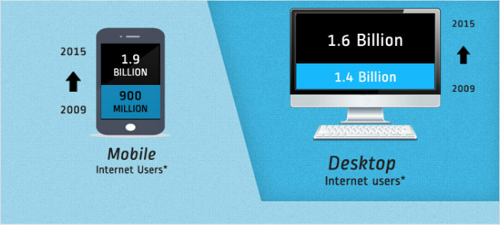
Mobile is Future
Since 2013 Mobile users accessing internet are more than computer users.

Slide 4
Why do you need Responsive web designs
The Number of devices, platforms and browser that need to work with your website is growing exponential rate.
New devices with varying screen resolution

Slide 5
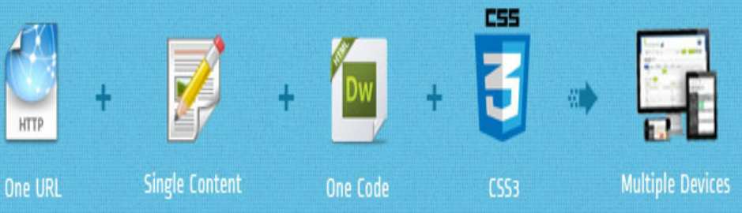
What is Responsive Web Designs
Responsive Websites respond to there environment.
Responsive Web Designing (RWD) is a process of designing a single website to be used and compatible on different portable or handy electronic devices with different Screen size , platform and orientation .

Slide 6
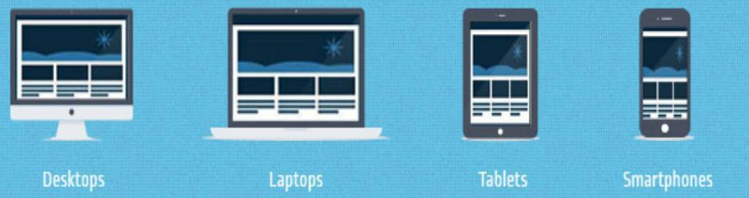
What is Responsive Web Designs
A Responsive Website serves the exact same page to every visitor but the design and layout of that page responds to the size of the visitors screen size. Every piece of content on a responsive site adapts to how it is being viewed – be it desktop PC , Mobile or TV.
All Type of devices are considered during design process.

Slide 7
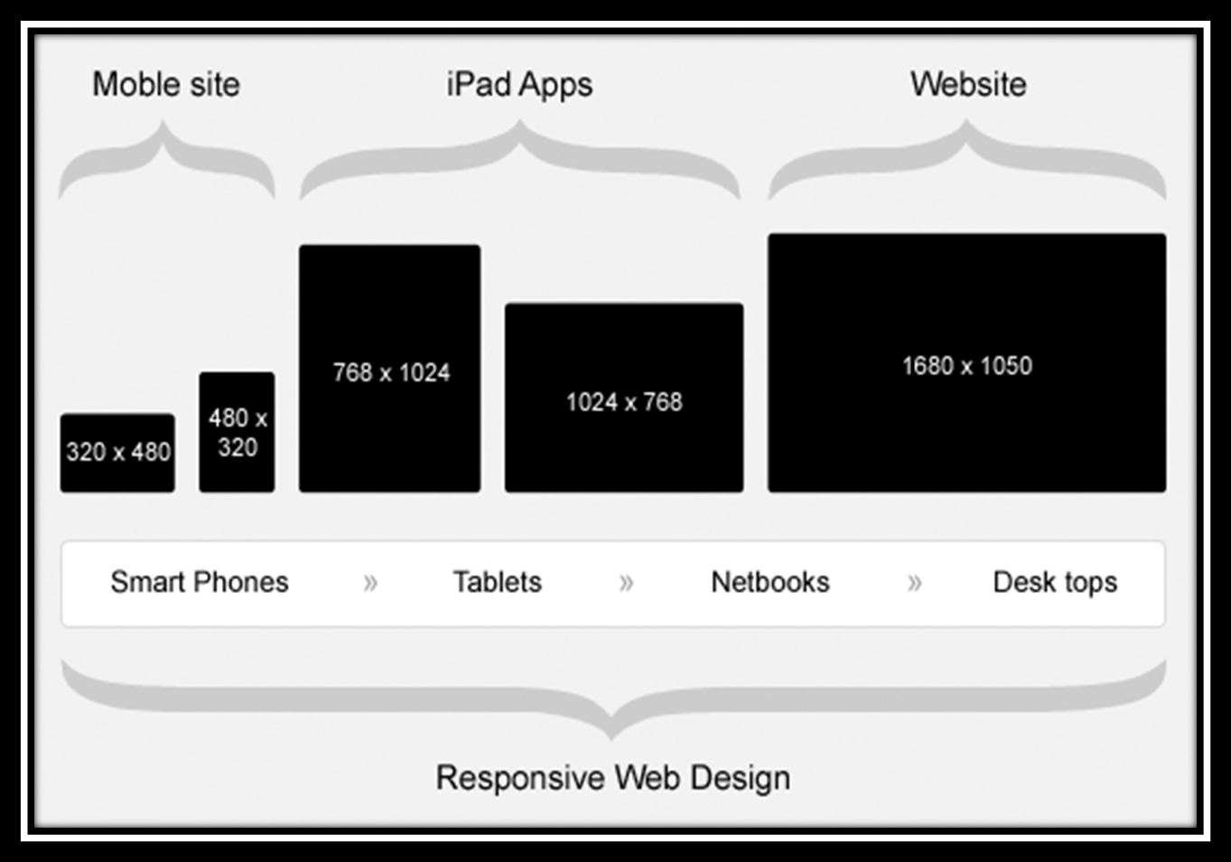
How does it work / Responsive Process

Slide 8
Adoptive Vs Responsive web designs
AWD depends on predefined screen sizing
RWD depends on flexible and fluid grids
AWD possesses a consistent and layered approach using scripting
RWD consists of a little more coding approach with fluid grids & CSS
AWD is recommended for end users with a limited budget or limited device types and screen sizes. It is also better for applications which have a lot of images which do not scale well
RWD is recommended for end users for whom budget is no question and who need a variance of mobile devices for their application to be implemented.

Slide 9
ADVANTAGES of Responsive Web Design
User Experience (UX): Website adjusts to any screen size, making it a good long-term solution to UX with the current plethora of devices (including mobile/tablet hybrids). Hiding elements which aren't crucial for mobile visitors helps to achieve their goals faster.
Analytics: One complete view for all the traffic. To get insights on the mobile visitors, create a "mobile-only" segment
Sharing/Linking: One URL to accumulate all of the shares, likes, tweets, and inbound links.
SEO: Going with the advantage above, one URL accumulates all links, PageRank, Page Authority, etc.

Slide 10
ADVANTAGES of Responsive Web Design
Development: RWD involves no redirects to take care of, no user-agent targeting.
Maintenance: Once your website is responsive, there's very little maintenance involved, as opposed to up-keeping a separate mobile site. It is not required to up-keep a user-agent list with all of the up-to-date mobile devices.
Information Architecture (IA): With a 1-to-1 relationship to the desktop site, mobile mimics the full site's IA, reducing the learning curve to get accustomed to using the mobile version.

Slide 11
Key benefits of Responsive web designs
Save money
Save Time
Better performance
Improved SEO
Wider browser support

Slide 12
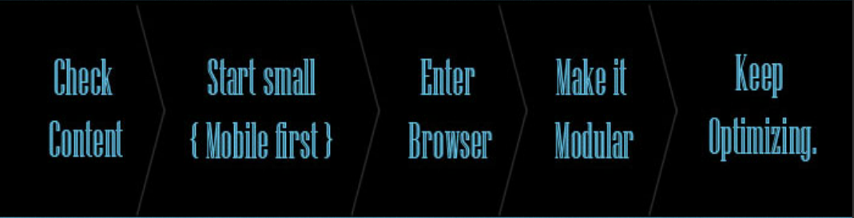
How do we design for RWD
Use the Mobile First Approach and favor Progressive Enhancement instead of the traditional Graceful Degradation

Slide 13
How does it works
A flexible grid
A flexible grid-based layout is one of the cornerstones of responsive design.
Stop using pixel-based layouts and start using percentages or the em for sizing
Flexible images and media
Adapt your images or other media to load differently depending on the device, either by scaling or by using the CSS overflow property
CSS3 media queries
You can use media queries to scope styles to specific capabilities, applying different styles based on the capabilities that match your query

Slide 14
Media Query example
body {
background-color: blue;
}
@media screen and (max-width: 960px) {
body {
background-color: red;
}
}
@media screen and (max-width: 768px) {
body {
background-color: blue;
}
}
@media screen and (max-width: 320px) {
body {
background-color: green;
}
}

Slide 15
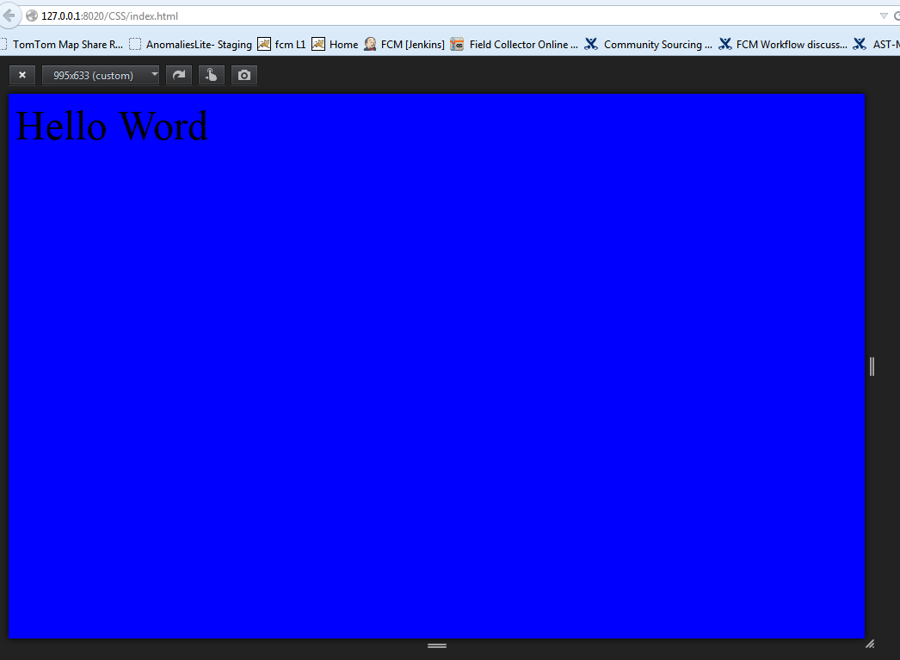
Media Query example

Slide 16
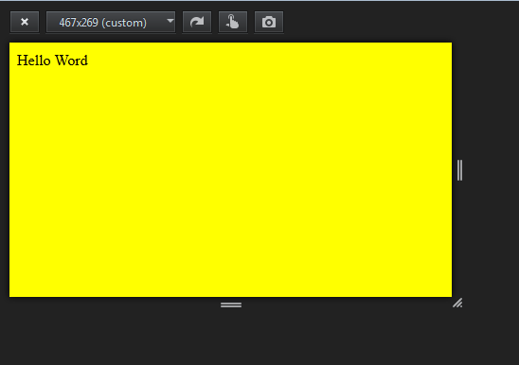
Media Query example

Slide 17
Important guide lines
Resizing image to fit the screen resolution.
Hiding non-essential elements especially for smaller screen.
Do not use web technologies that don’t work on mobile.
Make sure that website get loaded properly in seconds
Optimize your page for vertical scrolling.

Slide 18
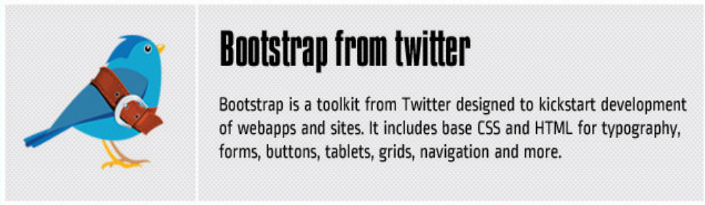
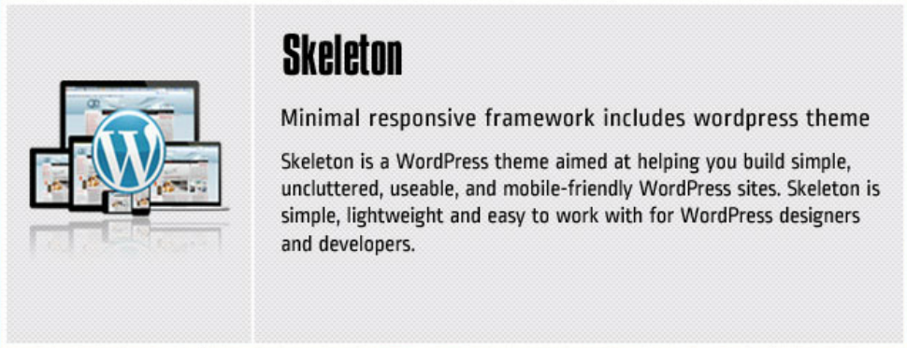
Frameworks

Slide 19
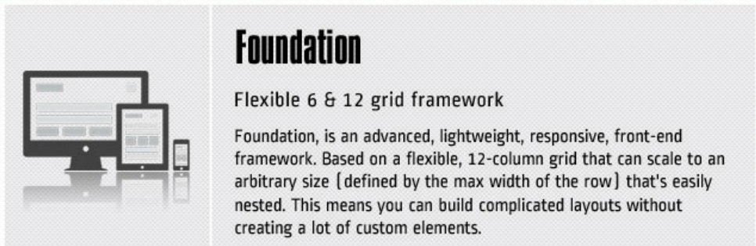
Frameworks

